Slide 1
Disjoint Sets Data Structure

Slide 2

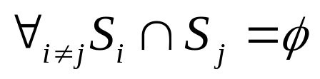
Disjoint Sets
Some applications require maintaining a collection of disjoint sets.
A Disjoint set S is a collection of sets
where
Each set has a representative which is a member of the set (Usually the minimum if the elements are comparable)

Slide 3
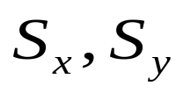
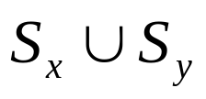
Disjoint Set Operations
Make-Set(x) – Creates a new set where x is it’s only element (and therefore it is the representative of the set). O(1) time.
Union(x,y) – Replaces by one of the elements of becomes the representative of the new set. O(log n) time.
Find(x) – Returns the representative of the set containing x O(log n) time

Slide 4
Analyzing Operations
We usually analyze a sequence of m operations, of which n of them are Make_Set operations, and m is the total of Make_Set, Find, and Union operations
Each union operations decreases the number of sets in the data structure, so there can not be more than n-1 Union operations

Slide 5
Linked List implementation
We maintain a set of linked list, each list corresponds to a single set.
All elements of the set point to the first element which is the representative
A pointer to the tail is maintained so elements are inserted at the end of the list
a
b
c
d

Slide 6
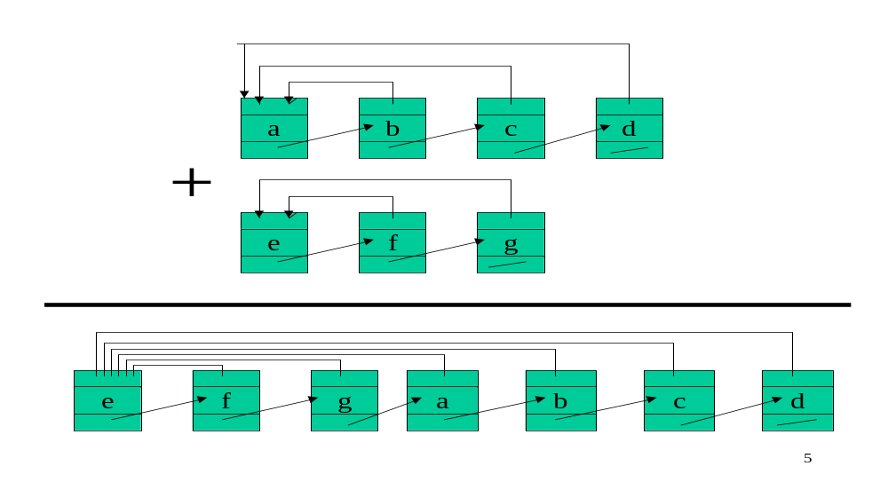
Union with linked lists

Slide 7

Analysis
Using linked list, MAKE_SET and FIND_SET are constant operations, however UNION requires to update the representative for at least all the elements of one set, and therefore is linear in worst case time
A series of m operations could take

Slide 8

Improvement – Weighted Union
Always append the shortest list to the longest list. A series of operations will now cost only
MAKE_SET and FIND_SET are constant time and there are m operations.
For Union, a set will not change it’s representative more than log(n) times. So each element can be updated no more than log(n) time, resulting in nlogn for all union operations

Slide 9
Disjoint-Set Forests
Maintain A collection of trees, each element points to it’s parent. The root of each tree is the representative of the set
We use two strategies for improving running time
  Union by Rank
  Path Compression
c
a
b
f
d

Slide 10
Make Set
MAKE_SET(x)
p(x)=x
rank(x)=0
x

Slide 11
Find Set
FIND_SET(d)
if d != p[d]
p[d]= FIND_SET(p[d])
return p[d]
c
a
b
f
d

Slide 12
Union
w
c
UNION(x,y)
link(findSet(x),
findSet(y))
link(x,y)
if rank(x)>rank(y)
then p(y)=x
else
p(x)=y
if rank(x)=rank(y)
then rank(y)++
x
a
b
f
y
d
z
c
w
a
b
f
x
y
d
z

